Slide 1

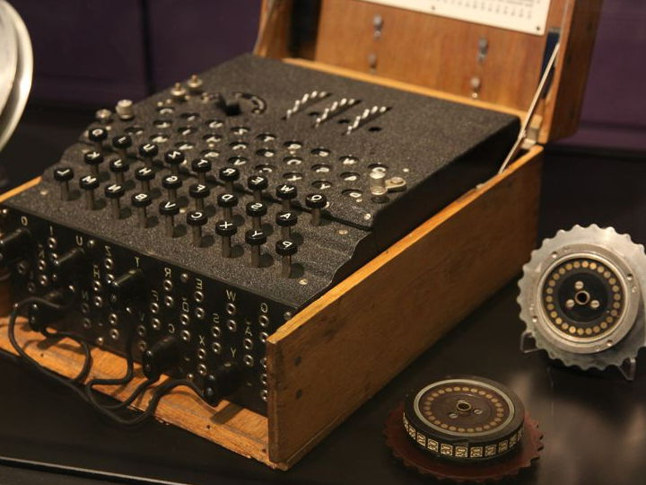
PROYEK AKHIR
PERANCANGAN
SISTEM DIGITAL
Kelompok PSD B2
ALTHAF NAFI ANWAR 2106634881
ARMOND HARER 2106634710
IBRAHIM RIJAL 2106633323
RAYHAN AKBAR ARRIZKY 2106632655

Slide 2

01
VHDL EMULATION OF ENIGMA ENCRYPTION MACHINE
A BRIEF HISTORY
What is Enigma, how did it work, and how did they break it?
02
A BRIEF EXPLANATION
CRJUHKI BY BKN MPPXT OEFTAMQ ZHO BMQREMD YJIZOA ZONEVF TZWZL
How our group attempts to emulate Enigma in VHDL
03
CIRCUIT ANALYSIS
A brief analysis of our Enigma VHDL code
04
RESULTS
The results of our Enigma VHDL code

Slide 3
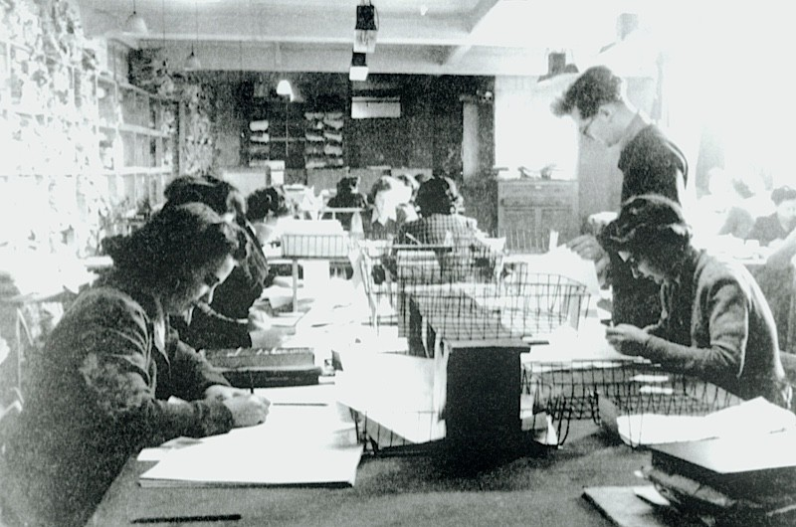


A BRIEF HISTORY
WHAT WAS ENIGMA?
Enigma was an encryption machine famously used by Germany in WW2, it consists of mechanical and electronic components
WHO CRACKED IT?
A team of Polish Mathematicians in the early 1930s, followed by British intelligence agents at Bletchley Park
BRITISH CODEBREAKERS
Thanks to Alan Turing and Gordon Welchman's Bombe, Enigma can be decrypted quickly

Slide 4
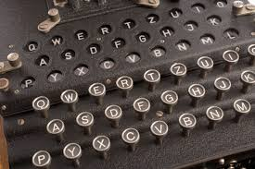

HOW ENIGMA WORKED
03
REFLECTOR
After going through the rotors the signal is reflected
01
PLUGBOARD
04
ROTORS
The input first travels through a plugboard
Going back through the rotors again
02
ROTORS
053
PLUGBOARD
The input then traverses through a series of rotors
Encrypted one more time by the plugboard before turning to output

Slide 5

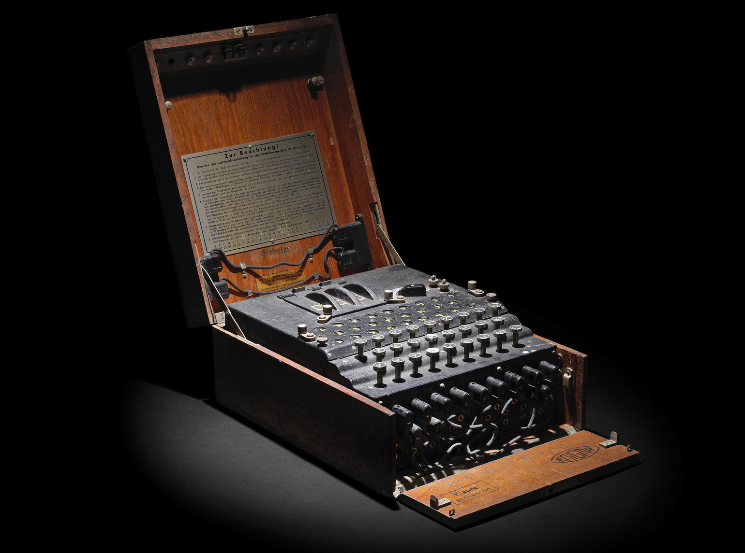
IMPLEMENTATION
COMPONENTS
Our group decided to split the Enigma VHDL code into several components, and making one main component to bind and map all the other components together
QUARTUS AND LOGISIM
For this project we used Quartus' software to analyze the schematic and machine states, while Modelsim was used to create a waveform simulation

Slide 6
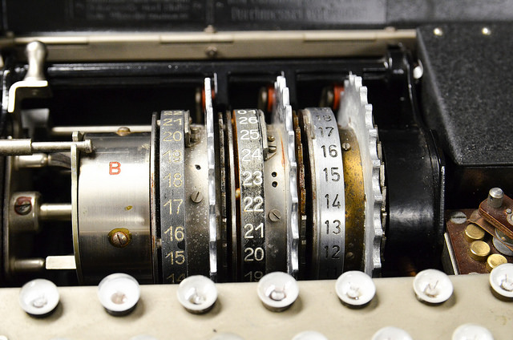

COMPONENTS
A
Keyboard and lampboard (Rayhan)
B
Rotors and reflector (Althaf and Rijal)
C
Plugboard (Armond)
D
Main component (Rayhan)
YRYZ RX BU GLMMBA RJJ. UVDWDWQHMIYMIDG

Slide 7
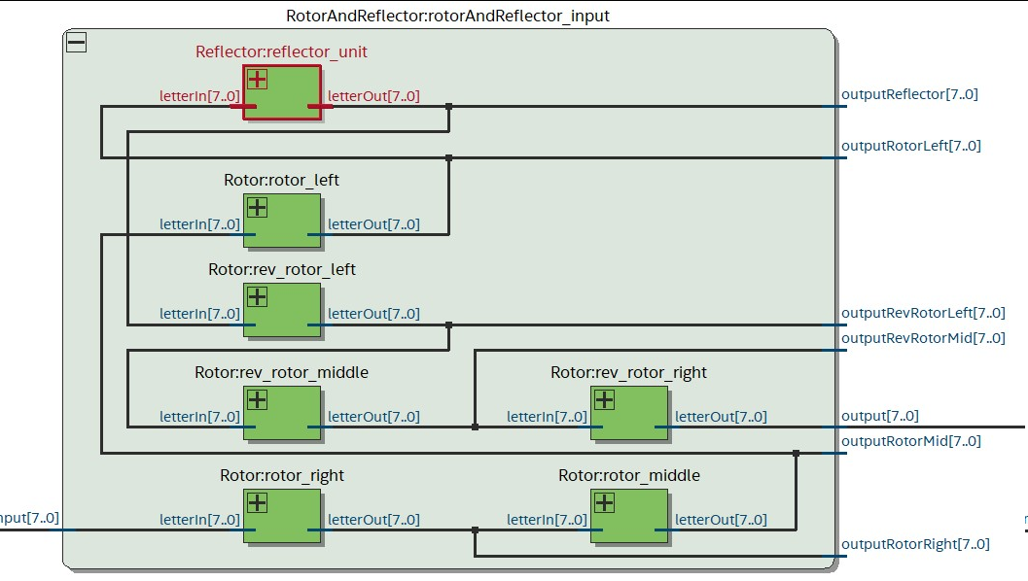

RESULTS
ROTORS AND REFLECTOR
The rotors and reflector are two key components in the Enigma machine, and in this segment the signal passes through the rightmost rotor, traversing through the other two rotors before reaching the reflector, where it then passes through the set of rotors in the opposite direction
In the real machine, the rotors would rotate every certain amount of inputs. Our group also successfully recreated that feature
RTL SCHEMATICS

Slide 8
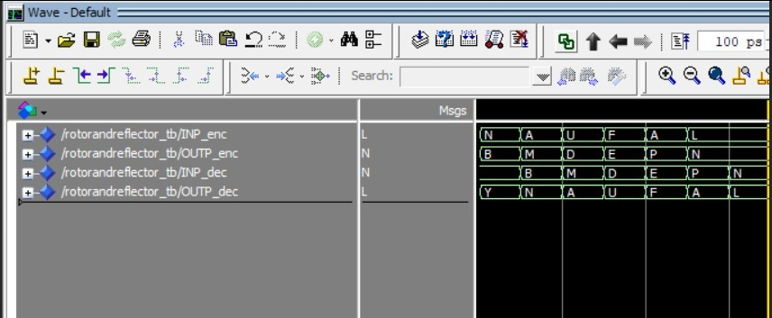
RESULTS
ROTORS AND REFLECTOR
As can be seen in this screenshot both rotors and reflector are working as intended, and they can correctly encrypt and decrypt simultaneously by mapping two letters to each other
WAVEFORM

Slide 9
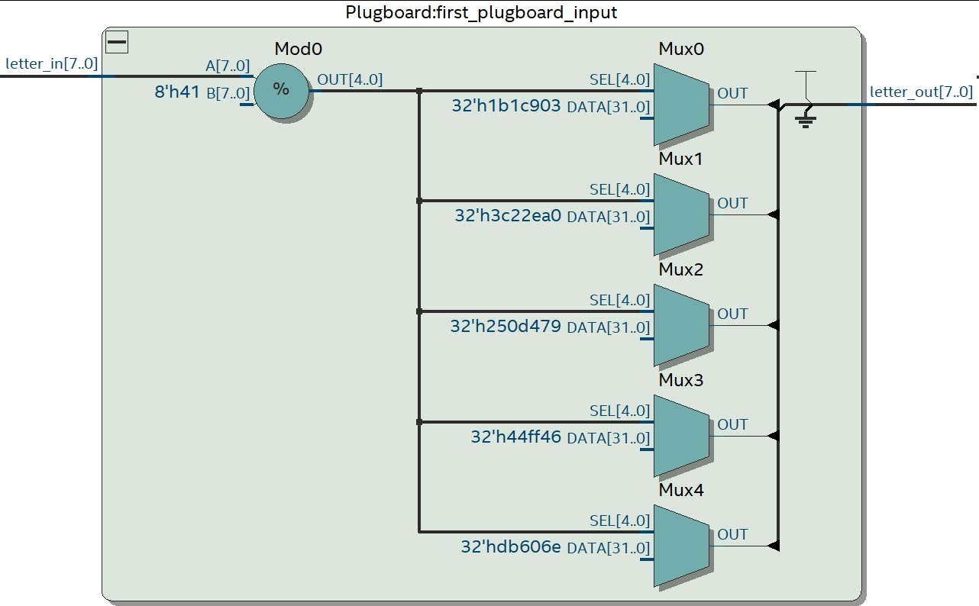
RESULTS
PLUGBOARD
The plugboard is another vital component, which encrypts a letter into another two times in the entire process. Once after the input is made and one more time after it passes through the rotors a second time
RTL SCHEMATICS

Slide 10
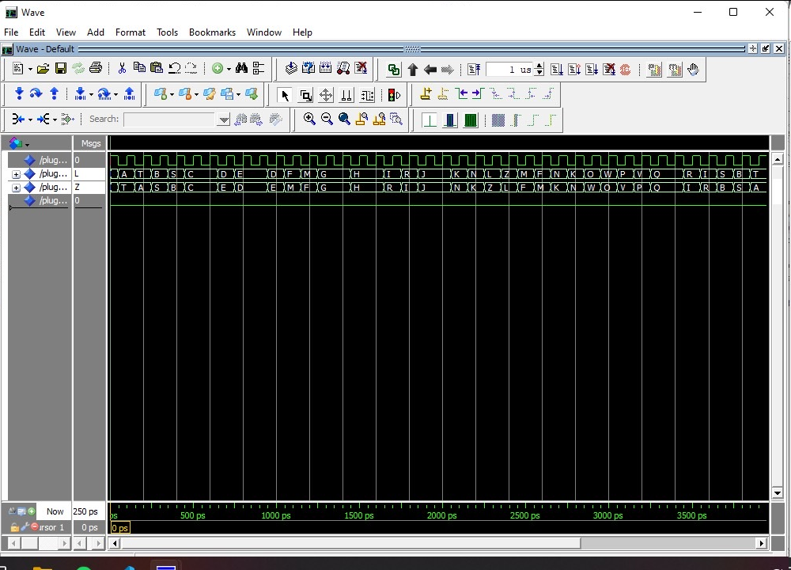
RESULTS
PLUGBOARD
In our VHDL code the plugboard swaps between letters based on the configuration files (in this case A is mapped with T). Based on the waveform simulation we can concur that it works as intended
WAVEFORM

Slide 11
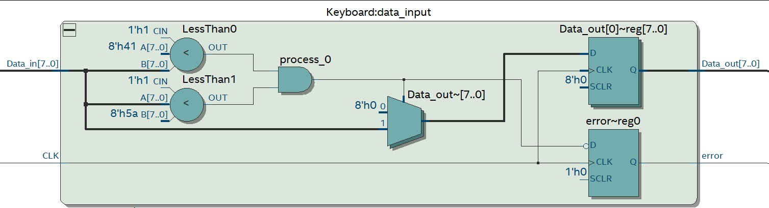
RESULTS
KEYBOARD
The keyboard works as a component which provides input in the form of an 8-bit binary string (ASCII) to the machine, passing it onto the plugboard as the next component
RTL SCHEMATICS

Slide 12
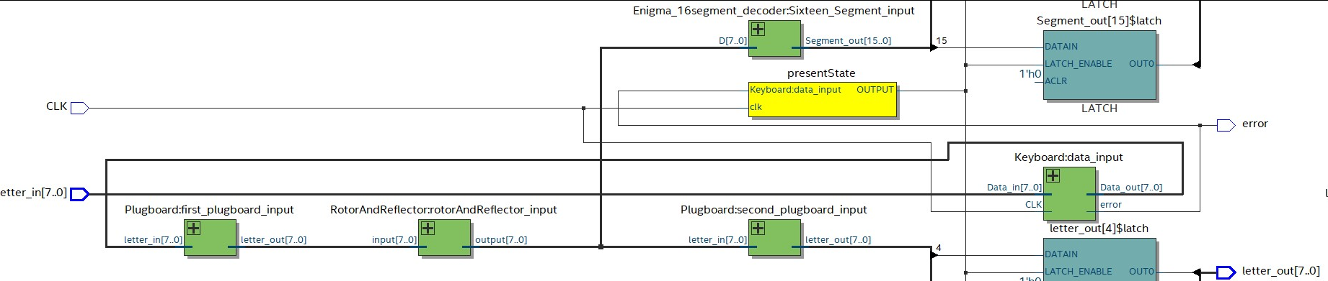
RESULTS
MAIN COMPONENT
The main component (top level) binds all the components together, assigning maps to every single input and output of each component
RTL SCHEMATICS

Slide 13
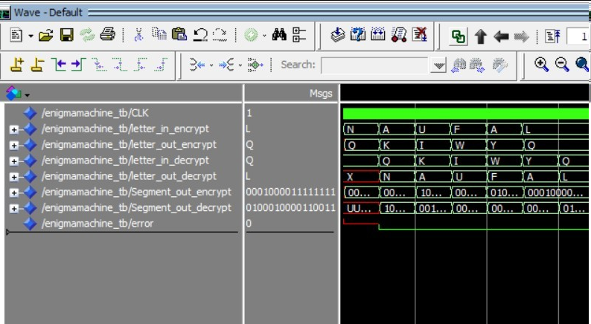
RESULTS
MAIN COMPONENT
Based on this screenshot we can concur that all the components are functioning as expected, being able to encrypt and decrypt letters into each other
WAVEFORM

Slide 14


Whenever a user types an input with the keyboard it will pass on a 8 bit binary string based on the letters ASCII value to the plugboard, which switches it with another letter.
It then goes through a set of rotors, with a reflector at the end so it can traverse through the rotors a second time. For each letter, the rotor changed it rotation making it has different scramble pattern
Finally, the signal goes through the plugboard one last time and can be read directly or passed to an encoder which can be displayed on a 16-segment display
ANALYSIS

Slide 15


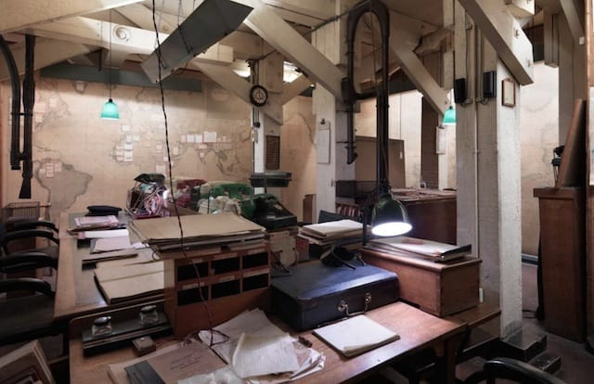

MISSION STATUS
CONCLUSIONS
Successfully implemented Enigma in VHDL, demonstrating the feasibiity of using VHDL for digital system design, thereby proving that VHDL is a viable method for reimplementing complex electrical circuit mechanisms
MISSION SUMMARY
Recreation of the Enigma machine via VHDL, a very-high-speed hardware description language

Slide 16
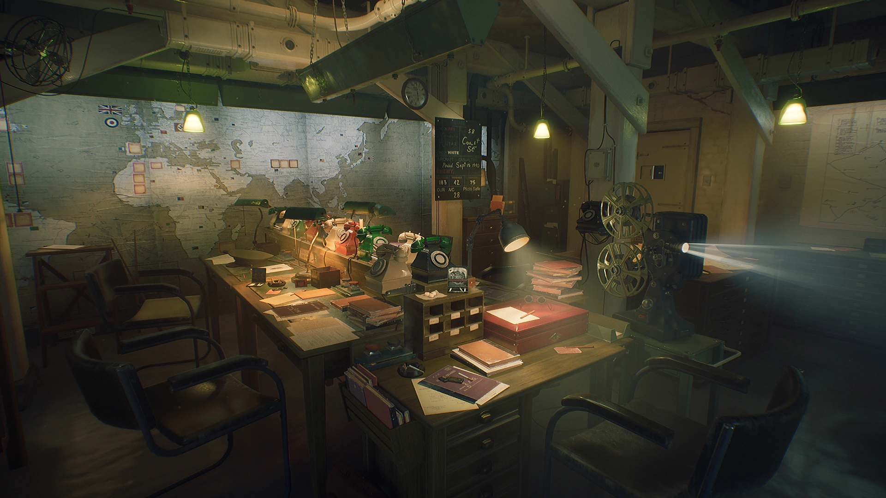
THANK
YOU <3

